Slide 1
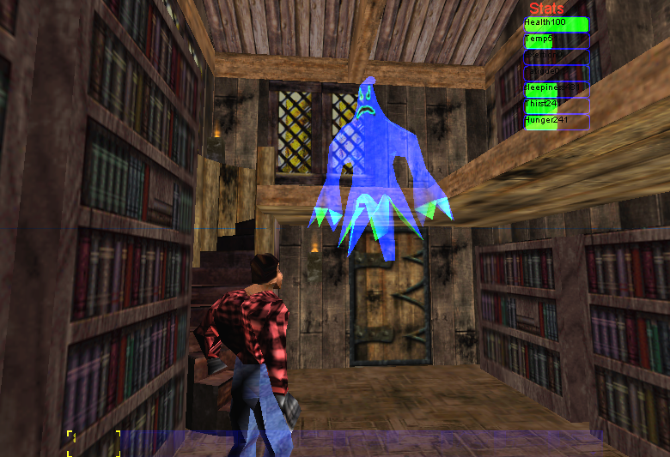
Director Agent
Brian Magerko
University of Michigan

Slide 2




IDA: An Interactive Drama Architecture
percepts
user actions
AI
Actor
Human player
direction
story content
Author
Haunt 2: Built in Unreal Tournament
AI Director
Interactive game, populated by human-like AI characters with an AI
director that dynamically controls an unfolding story.
Notes:
I did this with undergrad programmers.
Overall Research Project:
Study how to use advanced artificial intelligence (AI) in games to change the gaming experience.
Current games can’t have interactive plots, because they can’t respond to the actions of the players – they
rely on scripted AI’s that don’t understand the plot of the game and respond in character to the user.
Our goal is to create a game experience that combines the plot of a story and the interactivity of a game.
The user is a character in a immersive 3D virtual work, making choices, but also facing conflicts, challenges,
and emotional experiences.
The AI systems populate the world with human-like characters that have their own goals, knowledge, and
desires, that will create conflicts that the player will have to overcome.
There is an AI director that is following a plot written by a human and the director watches the game
and sends direction to the AI characters so that they will
keep the action going according to the plot – they must take the direction and execute it “in character”.
We don’t know if this is possible or even if this will lead to fun games, but we won’t find out unless we try.
So far we’ve developed the underlying infrastructure for the game – we use the Unreal engine for the game and the
Soar AI engine to control the characters. We are developing a game called Haunt II, where you are a ghost in a house and …

Slide 3
Director Execution Cycle
predicted behavior threatens an active plot point
timing constraint violated
execute direction
Haunt 2 environment
observable game features
all preconds for an active plot point are true
knowledge maintenance
plot monitoring
knowledge
set appropriate descriptors as true / false
model player
new plot-relevant fact
hypothesize entity knowledge
keep track of world state
mark plot points as active / done
new plot point has been set as active
Notes:
Bold roles
Step through the main roles:
Knowledge maintenance
Plot monitoring (then example on plot representation)
Reactive direction (then one example on perfoming postconditions and one based on timing constraint violation)
preemptive player (then example based on user predicted to be in the wrong room)
Problem: the model example should be obviously more subtle than what’s possible in the timing violation example.

Slide 4
Knowledge Maintenance
predicted behavior threatens an active plot point
timing constraint violated
execute direction
Haunt 2 environment
observable game features
all preconds for an active plot point are true
knowledge maintenance
plot monitoring
knowledge
set appropriate descriptors as true / false
model player
new plot-relevant fact
hypothesize entity knowledge
keep track of world state
mark plot points as active / done
new plot point has been set as active

Slide 5
Plot Monitoring
predicted behavior threatens an active plot point
timing constraint violated
execute direction
Haunt 2 environment
observable game features
all preconds for an active plot point are true
knowledge maintenance
plot monitoring
knowledge
set appropriate descriptors as true / false
model player
new plot-relevant fact
hypothesize entity knowledge
keep track of world state
mark plot points as active / done
new plot point has been set as active

Slide 6
Plot Representation
some plot content is instantiated at run-time
postconditions are directions given to synthetic characters
timing constraints represent pacing of story flow
Location( Sally, x )
Location( Innkeeper, x )
Proximity( Player, Sally, 2)
Timing( <=60 )
Talk( Sally, Innkeeper, small_talk)
Talk( Innkeeper, Sally, small_talk)
preconditions
actions
partially-ordered with other plot-points
Plots ordered for a scene:

Slide 7
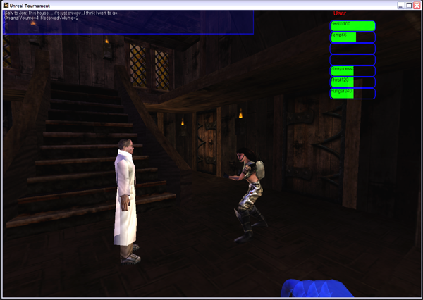
Story Direction
predicted behavior threatens an active plot point
timing constraint violated
execute direction
Haunt 2 environment
observable game features
all preconds for an active plot point are true
knowledge maintenance
plot monitoring
knowledge
set appropriate descriptors as true / false
model player
All preconditions are met
→ Perform plot content
new plot-relevant fact
new goal: small talk
hypothesize entity knowledge
keep track of world state
mark plot points as active / done
new plot point has been set as active
Notes:
Execute direction: all preconditions of a plot point have been fulfilled.
In this example, the state of the world is coherent with some element of the plot representation, therefore
actions for that particular plot point are being performed.
Pop up plot point too.

Slide 8
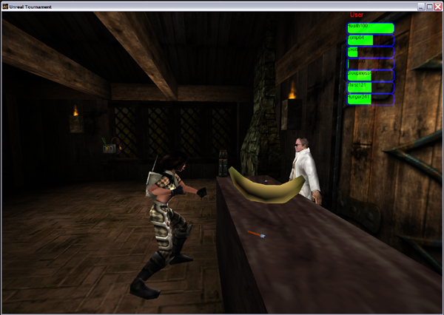
Reactive Direction
predicted behavior threatens an active plot point
timing constraint violated
execute direction
Haunt 2 environment
observable game features
all preconds for an active plot point are true
x is unbound
User is in library
Sally & Innkeeper are in the lounge
Time > 60 (constraint violated)
→ move Sally & Innkeeper
knowledge maintenance
plot monitoring
knowledge
set appropriate descriptors as true / false
model player
new plot-relevant fact
new goal: MoveTo(Library)
hypothesize entity knowledge
keep track of world state
mark plot points as active / done
new plot point has been set as active
Notes:
Similar to the main techniques used in MIMESIS and ALT-SIM.

Slide 9
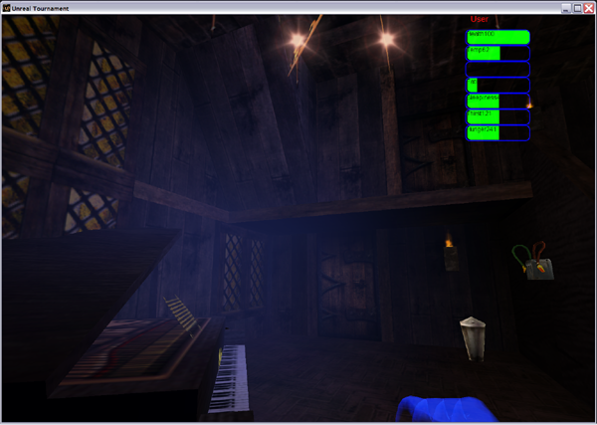
Preemptive Direction
predicted behavior threatens an active plot point
timing constraint violated
execute direction
Haunt 2 environment
observable game features
all preconds for an active plot point are true
User has been moving to new rooms…
Predicted goal: Explore
Predicted timing constraint
violation
knowledge maintenance
plot monitoring
knowledge
set appropriate descriptors as true / false
model player
new plot-relevant fact
hypothesize entity knowledge
keep track of world state
mark plot points as active / done
create sound
CRASH
new plot point has been set as active
Notes:
Not done in any other system!
“Why not direct all of the time?” – while direction is useful, having a guiding hand ALL the time could break believability as well….but even still, it’s not clear what truly is the most effective thing. We’re just beginning to explore the space.
Give the player the opportunity to experience plot content on his own terms.
If the preemptive direction doesn’t work, then modeling next time around will be less certain (or the constraint will be violated), and strong mediation techniques will need be used, such as bringing the characters to the player.

Slide 10
Single Modeling Run
world state
state copy
appear
explore
listen
P(a) = 0.2
P(e) = 0.6
P(l) = 0.2
result
{Success, 0.42}
goto-area
goto-sound
goto-light
P(ga|e) = 0.5
P(gs|e) = 0.3
P(gl|e) = 0.2
model
Notes:
Director creates an internal copy of world state
Facsimile of current world state
Includes hypothesized user knowledge
User model
Run in simulated world
Subset of Hauntbot agent
Goal hierarchy
Probabilistic selection of goals
“What would I do?”

Slide 11
Probabilistic Player Model
appear
explore
listen
…
P(a) = 0.2
P(e) = 0.6
P(l) = 0.2
goto-area
goto-sound
goto-light
P(ga|e) = 0.5
P(gs|e) = 0.3
P(gl|e) = 0.2

Slide 12
Player Prediction
Success
  Precondition is fulfilled before a timing constraint is violated
Failure
  Timing constraint is violated
Probabilistic sampling
Result determines:
  if the director preemptively directs
  how it directs preemptively

Slide 13
Probabilistic Sampling
Model returns a tuple, M → (R, P)
  R: success / failure
  P: probability of particular sequence of actions chosen
Model runs created iteratively until an author-defined limit ρ is reached
Notes:
P(Run_{x}) = P(Operator_{x1}, Operator_{x2}, …, Operator_{xn})

Slide 14
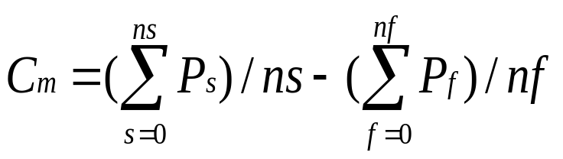
Probabilistic Sampling
Once modeling is complete, director computes confidence in the user fulfilling plot content
  -1 <= C_{m} <= 1
  s / f: individual run which yielded a success / failure
  P_{s / f}: likelihood of run m occurring
C_{m} > α >= 0 → success
C_{m} < α < 0 → insignificant success / failure & preemptive guidance is needed
Notes:
Confidence for a run m = the normalized sum of successes – the normalized sum of failures

Slide 15
Connecting Modeling to Director Actions
Preemptive direction chosen by score
Action scores are a f^{n} of modeling result, C_{m}
Director actions rated by a scoring function
  Score_{action} = (Sub * S_{action} + Eff * E_{action}) / 2
  S_{action} / E_{action}: authored rating for a particular director action
  Sub / Eff: weights assigned as a f^{n} of C_{m}

Slide 16
Assigning Score Weights
Score for actions computed at run-time:
  If 0 < α < C_{m}, then do not preemptively direct
  If 0 < C_{m} < α, then assign Sub > Eff
  If -1 + α < C_{m} < 0, then assign Sub == Eff
  If -1 < C_{m} < -1 + α, then assign Sub < Eff
effectiveness
no direction
-1
1
0
α
subtlety
Notes:
For example, if the director predicts that the user is going to look for Jon and Sally, but is fairly uncertain about it, it will prefer a more subtle action (like a floor creak sound) than if the prediction is a very confident failure (closer to a reactive technique, like creating a loud crashing sound).

Slide 17
Plot Point Choice
Story is partially-ordered
Which active plot point comes next?
Two-tiered approach
  Player choice
  Heuristic choice
Notes:
What if there is more than one candidate in the partial order to occur next?
Let player be main drive…
Heuristic choice prefers plot points that have a higher author-defined rating.

Slide 18
Nuggets and Coal
Nuggets
  IDA is functionally finished
  New theory of story direction
  Tells a story (“It works!”)
  Has influenced interactive training approaches
Coal
  Evaluation left to do
  Tells a story, just not a great one
  Low amount of interaction (“verbs”) in Haunt 2

Slide 19
Questions?
www.magerko.org/research
brian@magerko.org

